Slide 1


UML Class Diagram

Slide 2
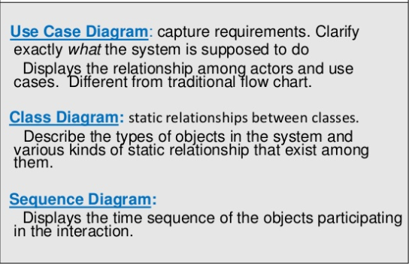
UML
UML stands for Unified Modeling Language
UML is a diagramming language designed for object-oriented programming
The UML represents a collection of best engineering practices that have proven successful in the modeling of large and complex systems
Types of UML diagram

Slide 3
Introduction
Steps involved in Class Design
1. Identify classes for the system.
2. Describe attributes and methods in each class.
3. Establish relationships among classes.
4. Create classes.

Slide 4
Discovering Classes
The key to OO programming is to model the application in terms of cooperative objects.
Careful design of classes is critical when a project is being developed.

Slide 5
Strategies for Discovering Classes
Step 1
Look for nouns in the problem description.
E.g., to design an IS for a university, you would identify Student, Lecturer and Course as classes.
Step 2
Determine the responsibilities of each class, i.e. the methods carried out by the objects of the class.
Look for verbs in the problem description and match the verbs to appropriate objects.
E.g., “a student registers for a course.”
Registering for courses is the responsibility of the Student class.
The Course class is involved in this operation as a collaborator for the operation.

Slide 6
Strategies for Discovering Classes
One popular way for facilitating the discovery process is by creating CRC cards (Classes, Responsibilities, and Collaborators)
Use an index card for each class, as shown in the figure below

Slide 7
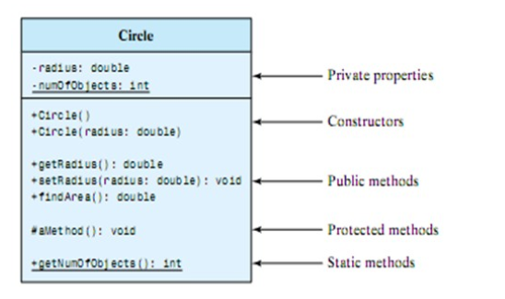
Member Access Modifier
Public (+)
Private (-)
Protected (#)
Package (~)
Derived (/)
Static (underlined)
Notes:
derived attribute: not stored, but can be computed from other attribute values

Slide 8
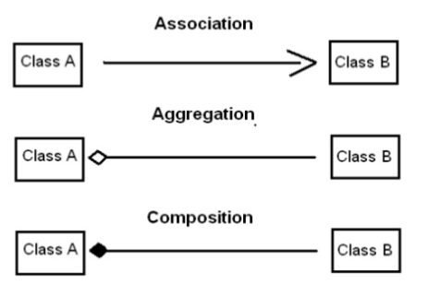
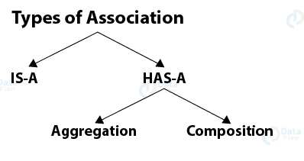
Discovering Class Relationships
Association
Aggregation
Composition
Dependency
Inheritance

Slide 9
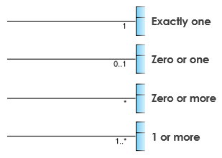
Association
Relationship between classes in a UML Class Diagram
They are represented by a solid line between classes
Cardinality is expressed in terms of :
One to one
One to many
Many to many

Slide 10
Association
Association represents a general binary relationship that describes an activity between two classes.
E.g.
A student taking a course is an association between the Student class and the Course class.
A faculty member teaching a course is an association between the Faculty class and the Course class.
take
teach
5..60
*
0..3
1
Student
Course
Faculty
Teacher

Slide 11




Example
Student has one or more Instructors
Using rolename
Name the association

Slide 12
Association
Note:
Labels
Role Name
Multiplicity
An association is usually represented as a data field in the class.

Slide 13
Note
There are many possible ways to implement relationships, e.g.:
The student and faculty information in the Course class can be omitted, since they are already in the Student and Faculty class.
If you do not need to know the courses a student takes or a faculty teaches, the data field courseList in Student or Faculty can be omitted.

Slide 14
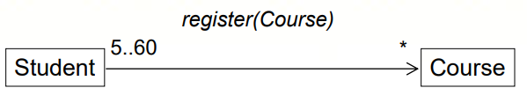
Association
The arrow is optional and specifies navigability.
No arrow implies bidirectional navigability

Slide 15
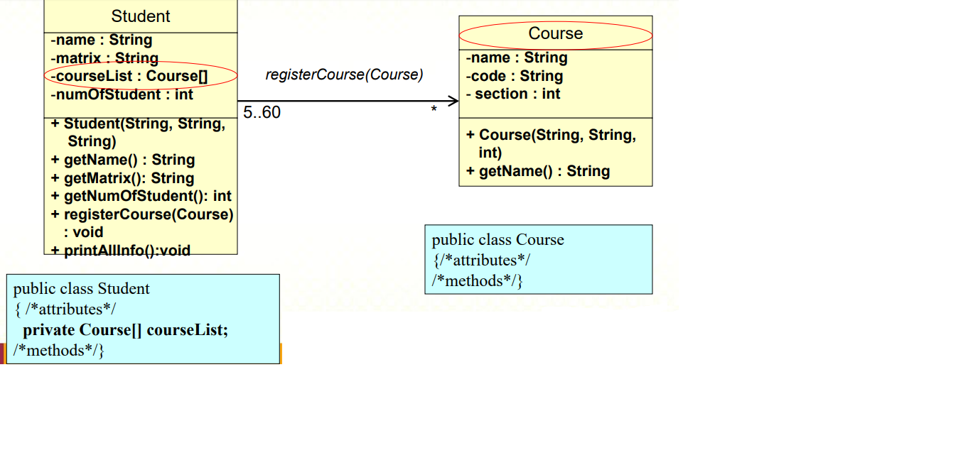
Student register Course An association is usually represented as a data field in the class.

Slide 16
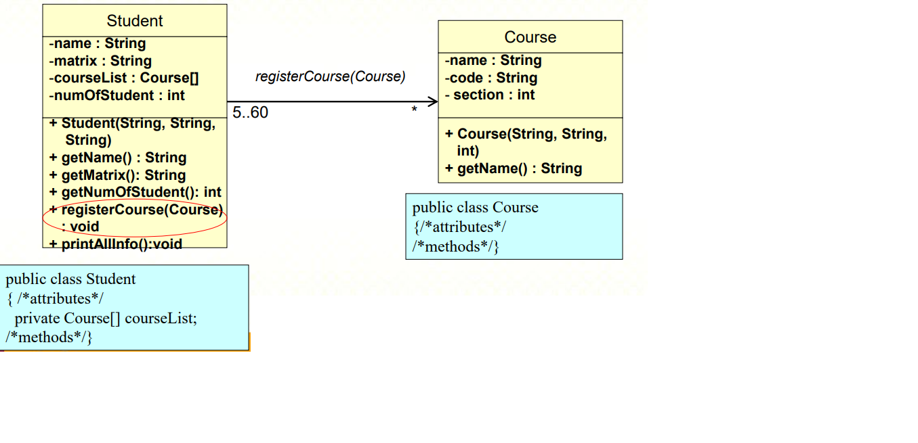
The relationship allows objects to call methods in other objects.

Slide 17
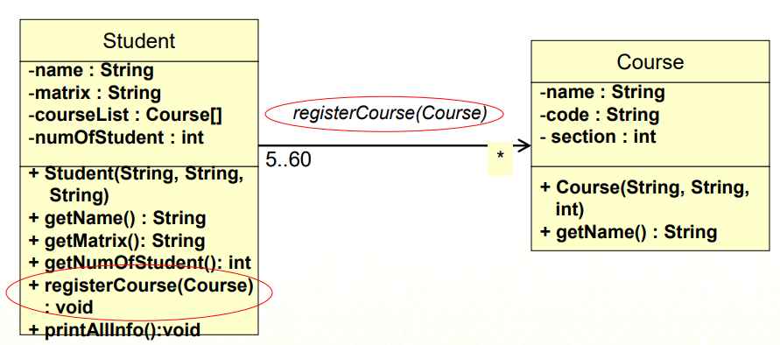
This is the same as an object sending another object a message.
Therefore, it is implemented as object references.

Slide 18
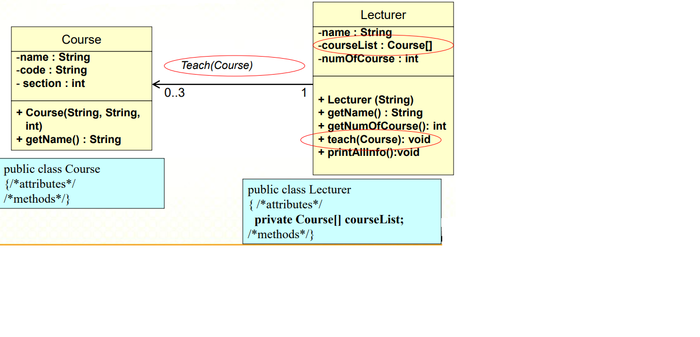
Lecturer teach Course
Write the classes and test the classes to show association relationships among them.

Slide 19
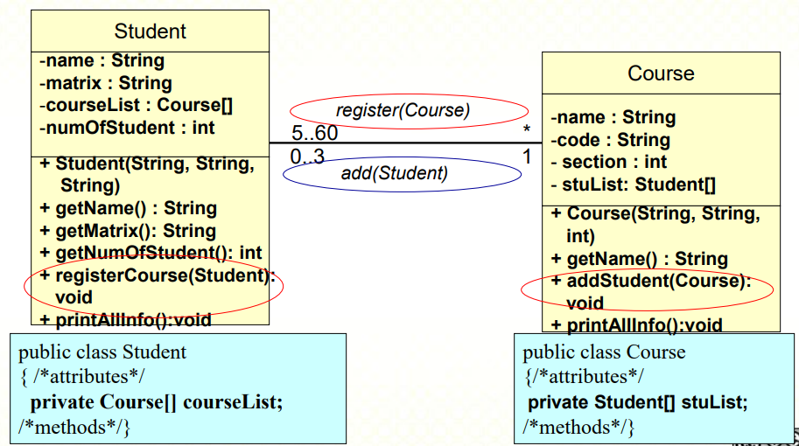
Bidirectional Relationship Student register Course and Course add Students

Slide 20
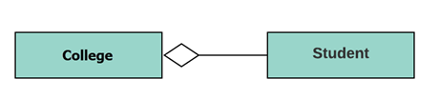
Aggregation
a special type of association that models a whole- part relationship between aggregate and its parts.
For example, the class college is made up of one or more student. In aggregation, the contained classes are never totally dependent on the lifecycle of the container. Here, the college class will remain even if the student is not available.

Slide 21
Aggregation
Aggregation is a special form of association, which represents an ownership relationship between two classes.
If an object is exclusively owned by an aggregated object, the relationship between the object and its aggregated object is referred to as composition
“a student has a name” is a composition relationship between the Student class
and the Name class.
“a student has an address” is an aggregation relationship between the Student
class and the Address class, since an address may be shared by several students.

Slide 22
Representing Aggregation in Classes
An aggregation relationship is usually represented as a data field in the aggregated class.
Aggregated class
Aggregating class
Aggregated class

Slide 23

Example
For example consider two classes Student class and Address class.
Every student has an address so the relationship between student and address is a Has-A relationship. But if you consider its vice versa then it would not make any sense as an Address doesn’t need to have a Student necessarily.
Why we need Aggregation?
To maintain code re-usability.
Suppose there are two other classes College and Staff along with above two classes Student and Address. In order to maintain Student’s address, College Address and Staff’s address we don’t need to use the same code again and again.

Slide 24
Representing Aggregation in Classes
If a person has several supervisors, you may use an array to store the supervisors.
public class Person {
private Person[] supervisors;
}

Slide 25

Composition
The composition is a special type of aggregation which denotes strong ownership between two classes when one class is a part of another class.
For example, if college is composed of classes student. The college could contain many students, while each student belongs to only one college. So, if college is not functioning all the students also removed.

Slide 26
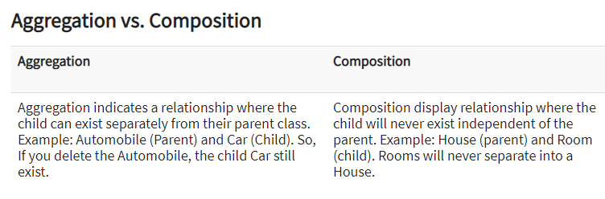

Slide 27
Dependency
A dependency describes a relationship between two classes where one (called client) uses the other (called supplier).
In UML, draw a dashed line with an arrow from the client class to the supplier class.
The Calendar class uses Date by setting calendar with a specified Date object. The relationship between Calender and Date can be described using dependency.
Client
Supplier

Slide 28
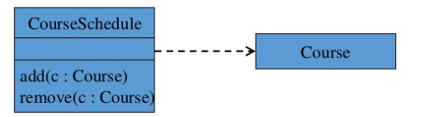
Dependency
Dependency indicates a semantic relationship between two or more elements
The dependency from CourseScedule to Course exists because Course is used in both the add and remove operations of CourseSchedule

Slide 29
Dependency
A dependency can be implemented using a method in the client class.
The method contains a parameter of the supplier class type, e.g.:
The Calendar class has the setTime(Date) method that sets a new time in the calendar.
public abstract class Calendar {
public void setTime(Date d)
. . .
}

Slide 30
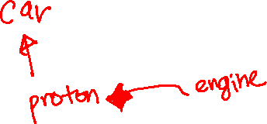
Inheritance (or Generalization)
Taxonomic relationship between a more general classifier and a more specific classifier
Each instance of the specific classifier is also an indirect of the general classifier
The specific classifier inherits the features of the more general classfier
Represent an “is-a” relationship

Slide 31
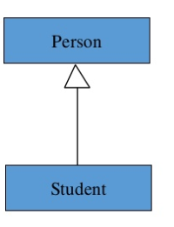
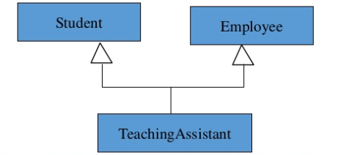

Slide 32
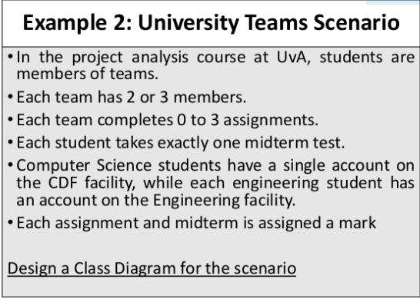
Example

Slide 33
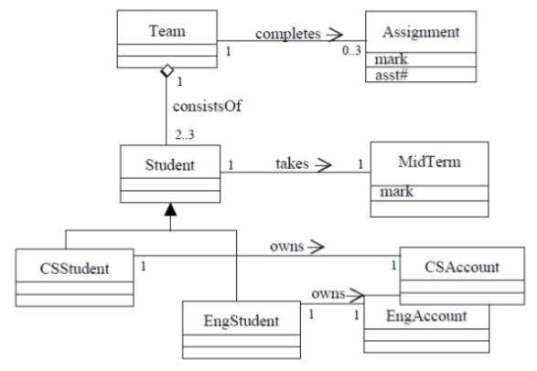

Slide 34
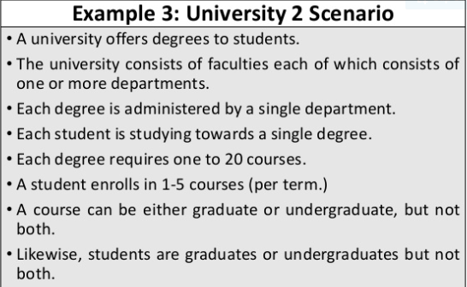

Slide 35
